Slide 1
C Programming
Rohit Kumar

Slide 2
C Tokens
A token is the smallest individual unit of a C program that the compiler recognizes. The C compiler breaks the source code down into tokens before further processing (parsing, compilation). C has six main types of tokens.
int age = 20 ;
↓ ↓ ↓ ↓ ↓
Keyword Identifier Operator Constant Symbol

Slide 3
Types of C Tokens
Keywords int, return, for
Identifiers total, age
Constants 10, 3.14, 'a'
String Literals "Hello", "Total: %d", "123"
Operators +, -, ==
Special Symbols { }, ;, ,

Slide 4
1. Keywords
Reserved words that have a predefined meaning in C. They cannot be used as identifiers (variable/function names).
Examples: int, return, for, if, else, while, void, char, float, break, continue, switch, case

Slide 5
2. Identifiers
First Character: Must be a letter (a-z, A-Z) or an underscore (_). It cannot start with a digit (0-9).
Allowed Characters: Letters, digits, and underscores. No spaces, no hyphens (-), and no special symbols (@, $, %, etc.).
Case Sensitivity: C is case-sensitive. age, Age, and AGE are three completely different variables living in different memory locations.
No Keywords: You cannot name a variable int, float, if, or return. These words already belong to the C language.

Slide 6
total_marks ➡️ Valid (Uses underscore perfectly).
2nd_place ➡️ Invalid (Starts with a number).
student name ➡️ Invalid (Contains a space).
_temp ➡️ Valid (Starts with an underscore).
price$ ➡️ Invalid (Contains the $ symbol).
double ➡️ Invalid (It is a reserved keyword).

Slide 7
3. Constants
Fixed values that do not change during program execution.
Integer Constants: Whole numbers without decimals (e.g., 10, -25, 0).
Floating-point Constants: Numbers with decimal points (e.g., 3.14, -0.001).
Character Constants: A single character enclosed in single quotes (e.g., 'a', 'Z', '5').

Slide 8
String Literals
Any sequence of characters enclosed in double quotes (" "). Even a sequence of digits in quotes is treated as a string, not a number.
Examples: "Hello", "Total: %d", "123"

Slide 9
operator
An operator is a symbol that tells the compiler to perform a specific mathematical, logical, or relational action.
Type Examples
Arithmetic +, -, *, /, %
Relational ==, !=, <, >
Logical &&, ||, !
Assignment =, +=, -=

Slide 10
Special Symbols
Symbol Purpose
{ } Block delimiters (function/loop body)
; Statement terminator
, Separator (in declarations, function args)
( ) Function calls, expressions
[ ] Array indexing

Slide 11
Data Types
In C programming, a data type tells the computer what kind of data we want to store in a variable.

Slide 12
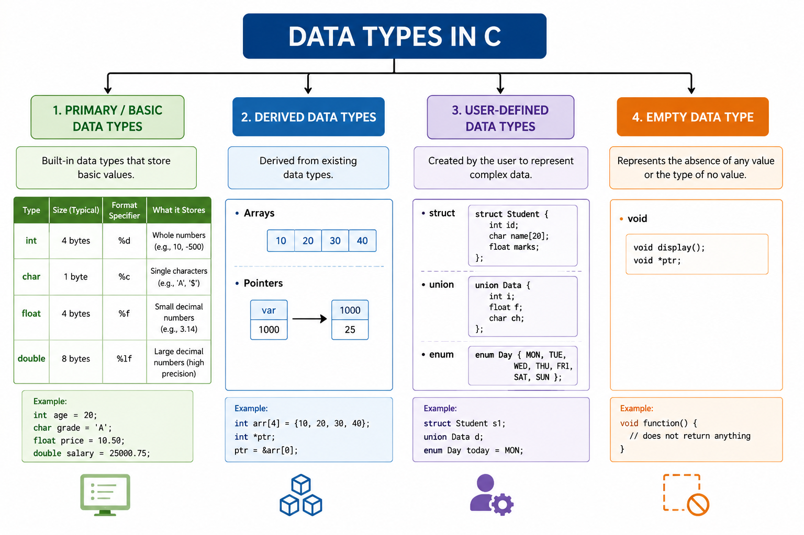

Slide 13
1. Primary (Basic) Data Types
Primary or Basic Data Types are the fundamental built-in data types provided by the C language. They are used to store basic kinds of values such as whole numbers, characters, and decimal numbers.
int — stores whole numbers
char — stores a single character
float — stores decimal numbers
double — stores decimal numbers with generally higher precision
Example:
int age = 20;
char grade = 'A';
float percentage = 85.5f;
double pi = 3.1415926535;

Slide 14
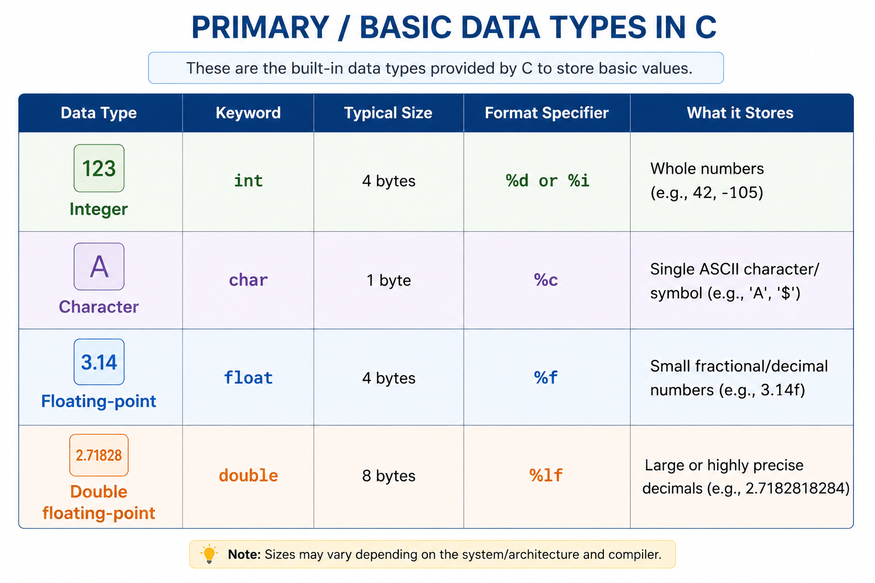

Slide 15
2. Type Modifiers
Type modifiers are keywords used with certain basic data types to modify their range, sign, or representation characteristics.
The four common type modifiers are:
short === 2 bytes
long ==== 8 bytes (long int → 4 or 8 bytes, depending on the system)
signed
unsigned

Slide 16
1. Size-Related Modifiers
short
short is commonly used when a smaller integer range is sufficient.
short int age = 25;
long
long is commonly used when a larger integer range is needed.
long int population = 5000000;

Slide 17
2. Sign Modifiers
signed
A signed integer can store both:
Positive values
Negative values
Zero
signed int temperature = -10;
unsigned
An unsigned integer cannot store negative values. It stores:
0
Positive values
unsigned int account_balance = 50000;

Slide 18
3. Derived Data Types
Arrays: A collection of multiple data elements of the same data type stored sequentially in memory (e.g., int scores[5];).
Pointers: Specialized variables designed to store the hardware memory address of another variable rather than a literal value (e.g., int *ptr;).
Functions: Executable blocks of code that wrap logic and optionally accept parameters or yield structured returns.

Slide 19
4. User-Defined Data Types
struct (Structure): A package that groups variables of different data types under a singular name (e.g., packing an int id and a float salary together).
union: Similar to a structure, but all internal member variables share the exact same physical memory block, conserving system space.
enum (Enumeration): A custom user-defined type used to assign highly readable word-based names to integer constants (e.g., mapping 0, 1, 2 to RED, GREEN, BLUE).

Slide 20
5. Void (The Empty Type)
void means no value.
It is commonly used when a function does not return a value.
Example:
void display()
{
printf("Hello");
}

Slide 21
